Slide 1
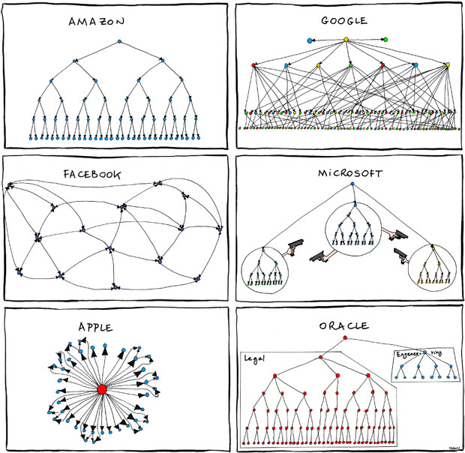

Slide 2
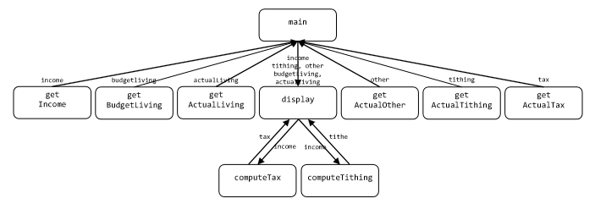
Intro | Explanation | Advantages | Appropriate | Disadvantages | Inappropriate | Effectiveness | Demonstration

Slide 3
Structure Charts
Joshua Jolley, Brenton Krieger, Bruce Niendorf, Jonathan Romrell
Intro | Explanation | Advantages | Appropriate | Disadvantages | Inappropriate | Effectiveness | Demonstration
Notes:
Brent

Slide 4
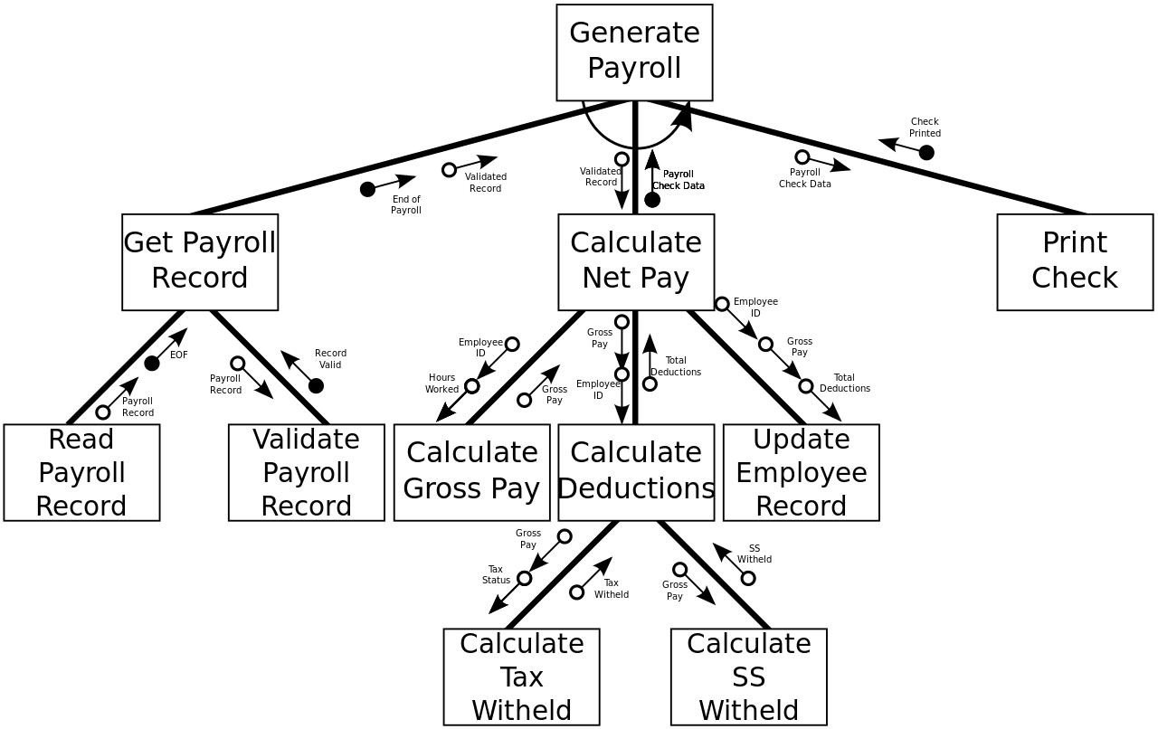
Structure Chart Explanation
"A Structure Chart in software engineering and organizational theory, is a chart which shows the breakdown of a system to its lowest manageable levels. They are used in structured programming to arrange program modules into a tree."
http://en.wikipedia.org/wiki/Structure_chart
http://upload.wikimedia.org/wikipedia/commons/e/e7/CPT-Structured_Chart_Example.svg
Intro | Explanation | Advantages | Appropriate | Disadvantages | Inappropriate | Effectiveness | Demonstration

Slide 5
Structure Chart Composition
Structure charts consist of:
Modules
Standard Modules
Library Modules
Couples
Data Couples
Control Couples
Conditions
Loops
http://upload.wikimedia.org/wikipedia/commons/e/e7/CPT-Structured_Chart_Example.svg
Intro | Explanation | Advantages | Appropriate | Disadvantages | Inappropriate | Effectiveness | Demonstration

Slide 6
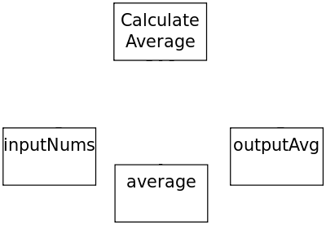
Modules
http://en.wikibooks.org/wiki/A-level_Computing/AQA/Problem_Solving,_Programming,
_Data_Representation_and_Practical_Exercise/Problem_Solving/Structure_charts
Intro | Explanation | Advantages | Appropriate | Disadvantages | Inappropriate | Effectiveness | Demonstration

Slide 7
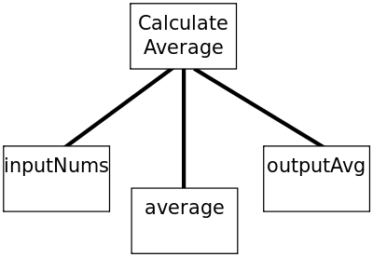
Connections / Relationships
http://en.wikibooks.org/wiki/A-level_Computing/AQA/Problem_Solving,_Programming,
_Data_Representation_and_Practical_Exercise/Problem_Solving/Structure_charts
Intro | Explanation | Advantages | Appropriate | Disadvantages | Inappropriate | Effectiveness | Demonstration

Slide 8
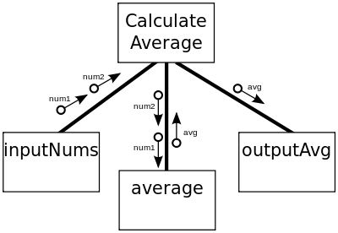
Data Couples
http://en.wikibooks.org/wiki/A-level_Computing/AQA/Problem_Solving,_Programming,
_Data_Representation_and_Practical_Exercise/Problem_Solving/Structure_charts
Intro | Explanation | Advantages | Appropriate | Disadvantages | Inappropriate | Effectiveness | Demonstration

Slide 9
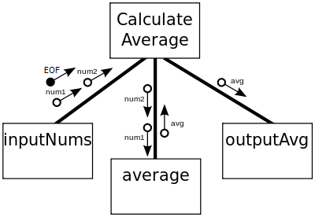
Control Couples
http://en.wikibooks.org/wiki/A-level_Computing/AQA/Problem_Solving,_Programming,
_Data_Representation_and_Practical_Exercise/Problem_Solving/Structure_charts
Intro | Explanation | Advantages | Appropriate | Disadvantages | Inappropriate | Effectiveness | Demonstration

Slide 10
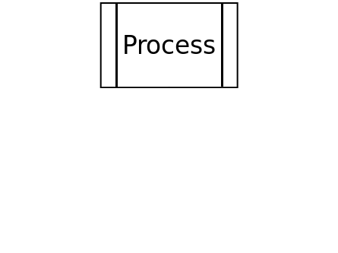
Library Module
http://en.wikibooks.org/wiki/A-level_Computing/AQA/Problem_Solving,_Programming,
_Data_Representation_and_Practical_Exercise/Problem_Solving/Structure_charts
Intro | Explanation | Advantages | Appropriate | Disadvantages | Inappropriate | Effectiveness | Demonstration

Slide 11
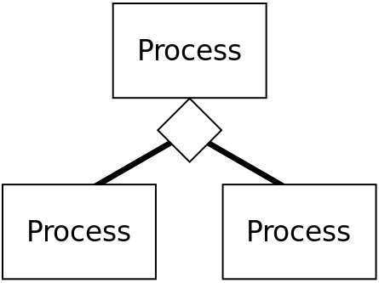
Conditional
http://en.wikibooks.org/wiki/A-level_Computing/AQA/Problem_Solving,_Programming,
_Data_Representation_and_Practical_Exercise/Problem_Solving/Structure_charts
Intro | Explanation | Advantages | Appropriate | Disadvantages | Inappropriate | Effectiveness | Demonstration

Slide 12
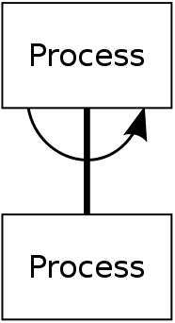
Loop / Iteration
http://en.wikibooks.org/wiki/A-level_Computing/AQA/Problem_Solving,_Programming,
_Data_Representation_and_Practical_Exercise/Problem_Solving/Structure_charts
Intro | Explanation | Advantages | Appropriate | Disadvantages | Inappropriate | Effectiveness | Demonstration

Slide 13

Advantages
Check for cohesion
Visualize coupling
See the process
http://cdn2.business2community.com/wp-content/uploads/2012/07/customer-experience-service-standout.jpg
Intro | Explanation | Advantages | Appropriate | Disadvantages | Inappropriate | Effectiveness | Demonstration
Notes:
Jolley
http://www.hit.ac.il/staff/leonidM/information-systems/ch63.html

Slide 14
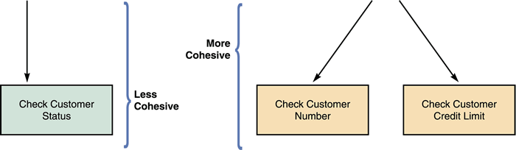
Advantages – Check for cohesion
www.philadelphia.edu.jo/academics/aghool/uploads/chap5%20seq2.ppt
Intro | Explanation | Advantages | Appropriate | Disadvantages | Inappropriate | Effectiveness | Demonstration

Slide 15
Advantages – Visualize Coupling
http://en.wikibooks.org/wiki/A-level_Computing/AQA/Problem_Solving,_Programming_Data_Representation_and_Practical_Exercise/Problem_Solving/Structure_charts
Intro | Explanation | Advantages | Appropriate | Disadvantages | Inappropriate | Effectiveness | Demonstration

Slide 16
Abstraction – See the process
http://homepages.rpi.edu/~ravit/sad/software.ppt
Intro | Explanation | Advantages | Appropriate | Disadvantages | Inappropriate | Effectiveness | Demonstration

Slide 17
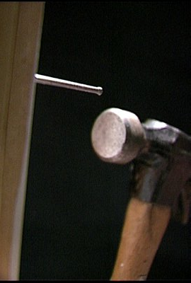
Discuss when it is appropriate
Procedural Programming
When modularity is a priority
When you’re ready to develop a lower level of abstraction than architecture, but not quite ready for pseudocode
http://davidavellan.com/wp-content uploads/2013/11 /hammer-and-nail.jpg
Intro | Explanation | Advantages | Appropriate | Disadvantages | Inappropriate | Effectiveness | Demonstration
Notes:
Bruce

Slide 18
Disadvantages
Shows asynchronous connections poorly.
Adds confusion in large designs.
Intro | Explanation | Advantages | Appropriate | Disadvantages | Inappropriate | Effectiveness | Demonstration
Notes:
Brent's

Slide 19
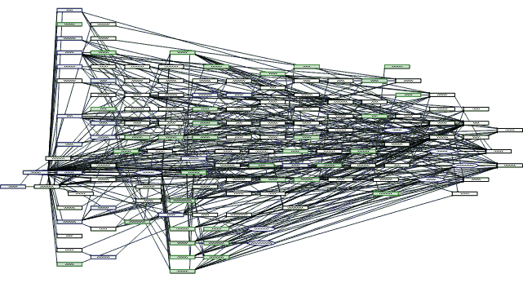
Intro | Explanation | Advantages | Appropriate | Disadvantages | Inappropriate | Effectiveness | Demonstration

Slide 20
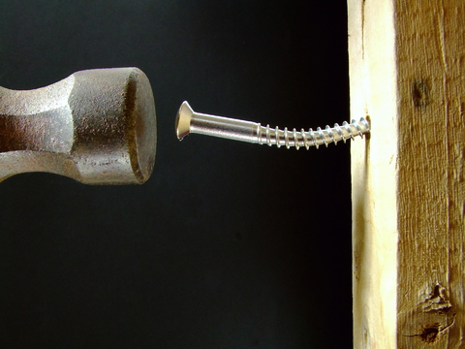
When it is inappropriate
Object-oriented programming
Very large projects
http://tucsonbdg.com/wp-content/uploads/2013/ 01/Hammer-and-Screw.jpg
Intro | Explanation | Advantages | Appropriate | Disadvantages | Inappropriate | Effectiveness | Demonstration
Notes:
Bruce

Slide 21
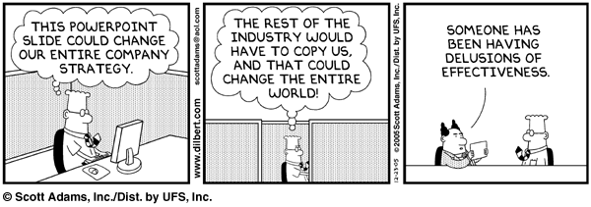
Effectiveness in representation
Not stuck in data types or pseudocode
Lacks sequential order
Effectively shows coupling and cohesion
http://1.bp.blogspot.com/_biVuYFlfreo/S-L1t-WtUYI/AAAAAAAABP0/Z5WmziRx2gU/s640/Delusion.gif
Intro | Explanation | Advantages | Appropriate | Disadvantages | Inappropriate | Effectiveness | Demonstration
Notes:
Jolley

Slide 22
Demonstration
Construct a structure chart for a madlib program?
Intro | Explanation | Advantages | Appropriate | Disadvantages | Inappropriate | Effectiveness | Demonstration

